Slide 1
WEB3.0 SMART INTERIOR DESIGN
HELIX++

Slide 2
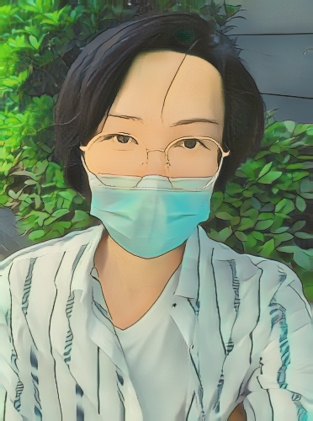
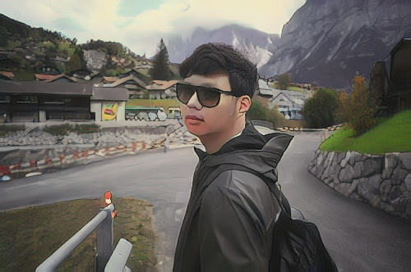
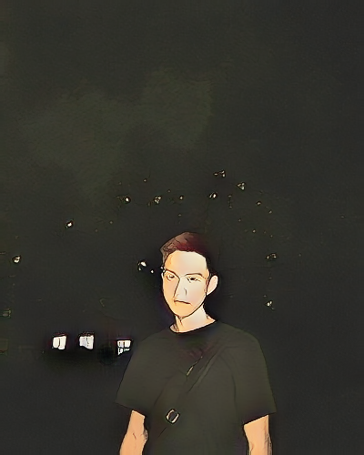
Members
YEXING LI
CHENCHEN TANG
YUZHANG JIANG

Slide 3
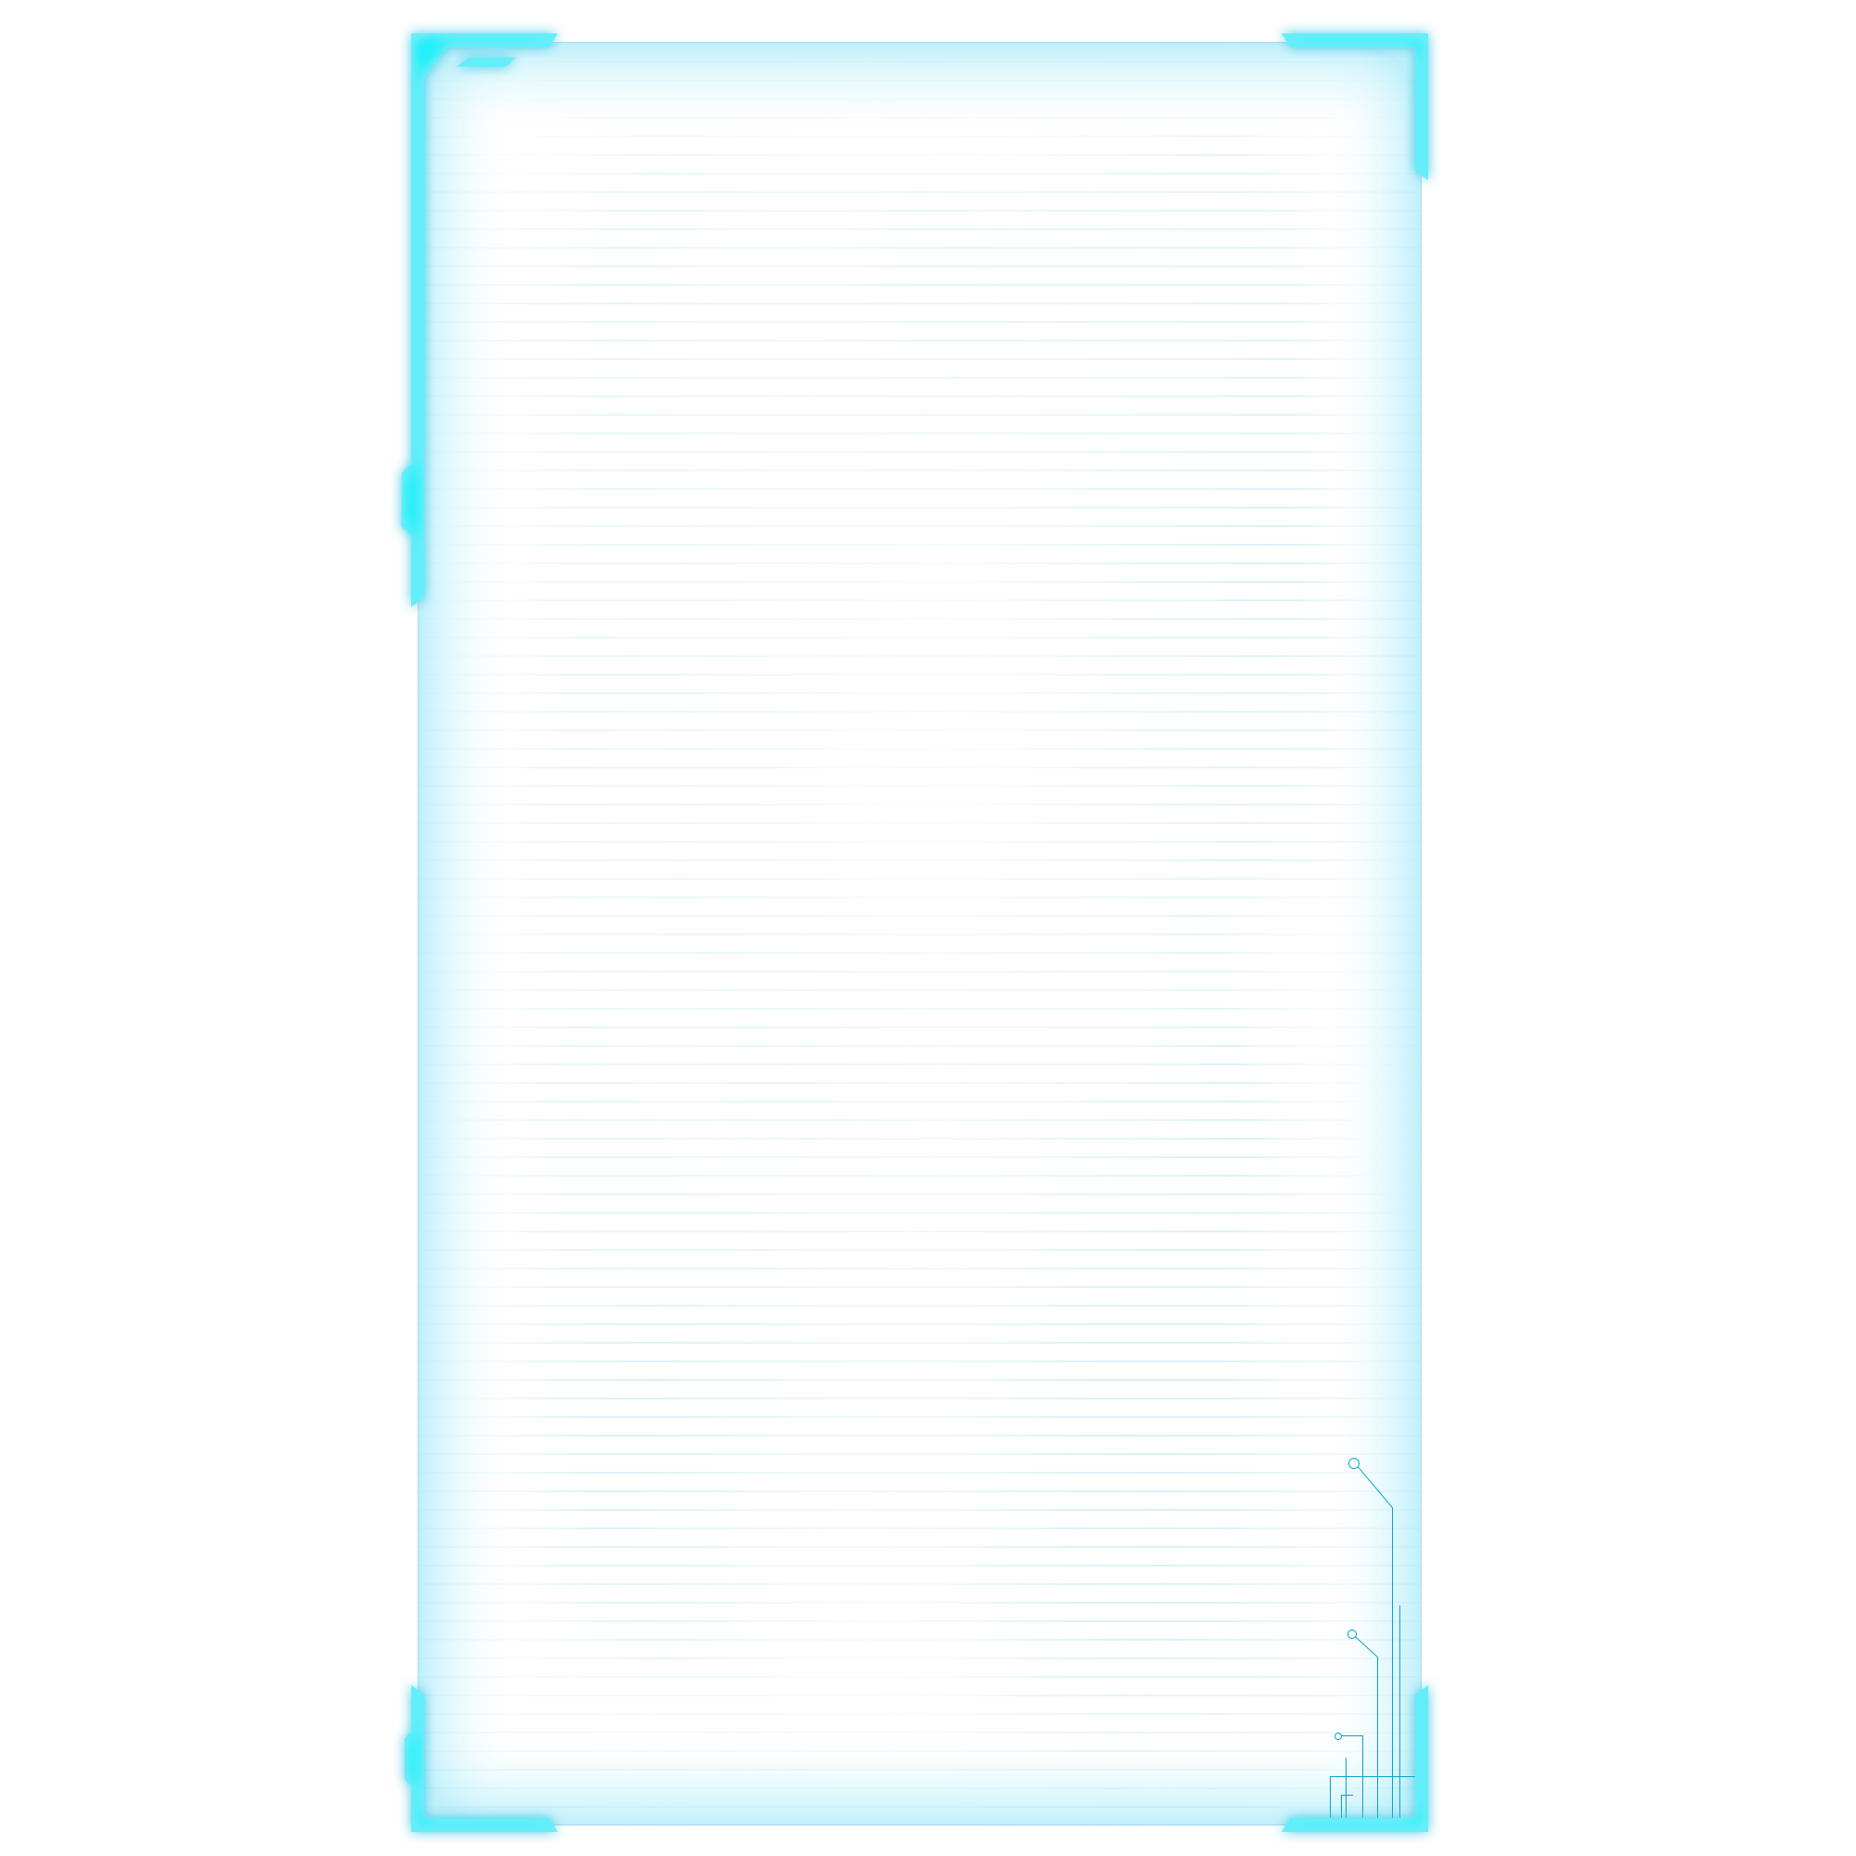
Problems
Creation copyright protection issues in the interior design industry
Restricted secondary creation in the interior design industry

Slide 4
Solutions
Using blockchain technology to reasonably record the creation and conversion process of works.
Supporting full-process viewing of works. It can trace the source of all multiple creation works with one click.
Providing secondary creation capabilities based on other people's works.
Utilizing copyright protection capabilities, enrich creative space, and accelerate industry exchanges.

Slide 5
Features
IPFS
Unreal Engine
Venachain
Artificial Intelligence

Slide 6
Process
0 1
0 3
NFT
Release
0 2
0 4
Creation
Transaction

Slide 7

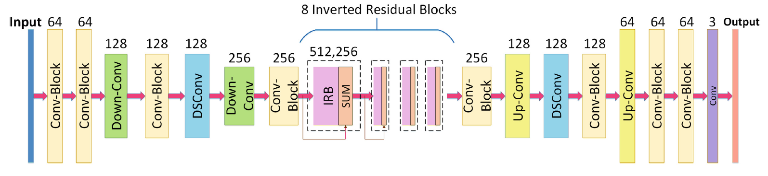
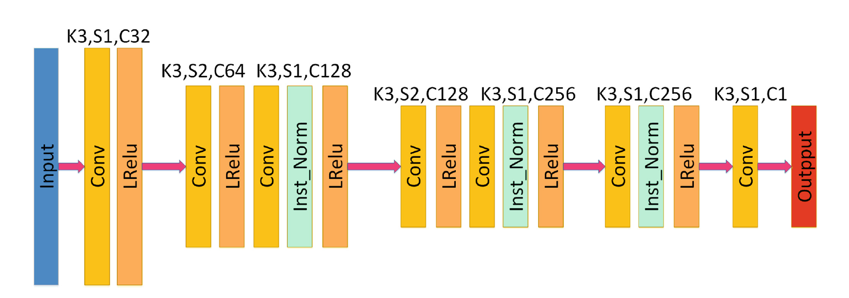
ACG NFT

Slide 8
Style Transfer
Have you ever imagined seeing the world through the eyes of Vincent van Gogh, Pablo Picasso or Wassily Kandinsky - a world full of strokes and brushes?
Style transfer is a computer vision technique that allows us to compose the content of an image in the style of another image.
At the beginning of Metaverse, there are few materials, while the traditional method requires users to construct manually. Our method allows users to customize the generation of furniture, floors, walls, etc. of various materials.

Slide 9
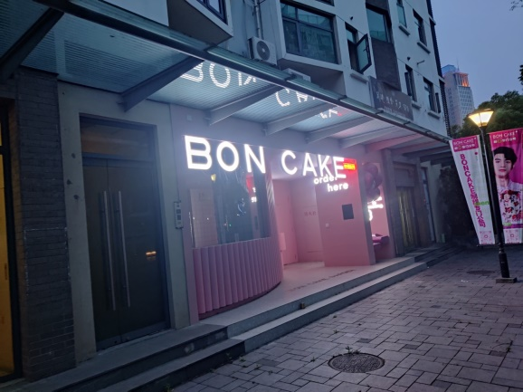
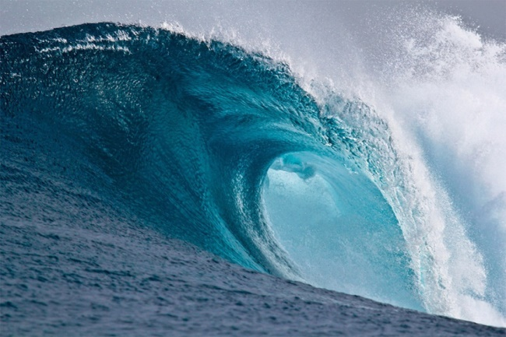
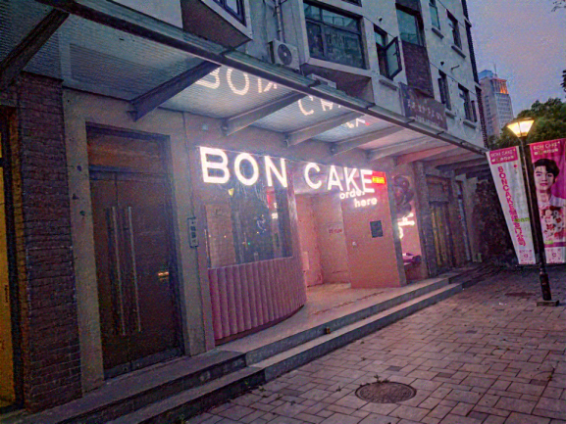
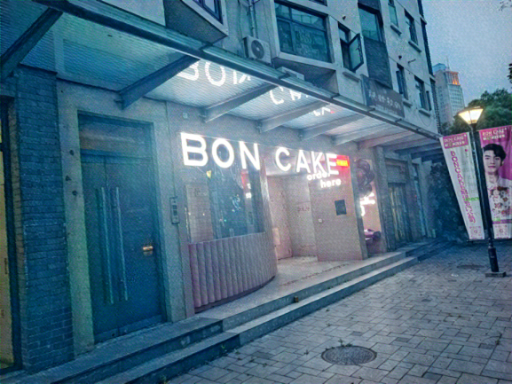
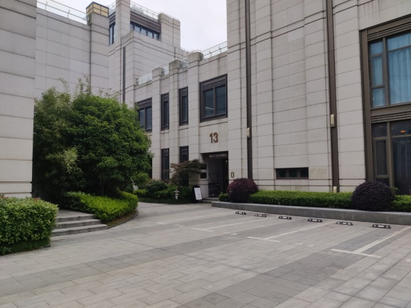

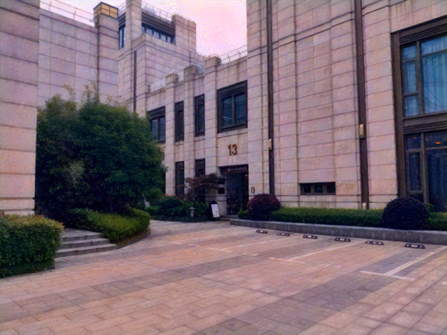
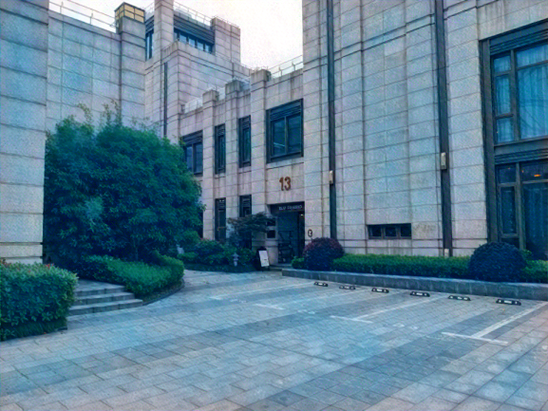
Filters

Slide 10
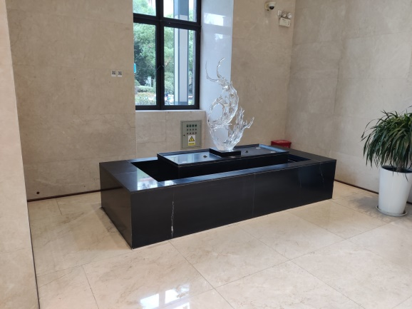
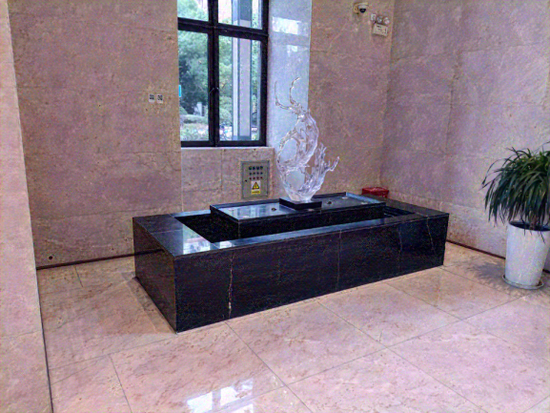
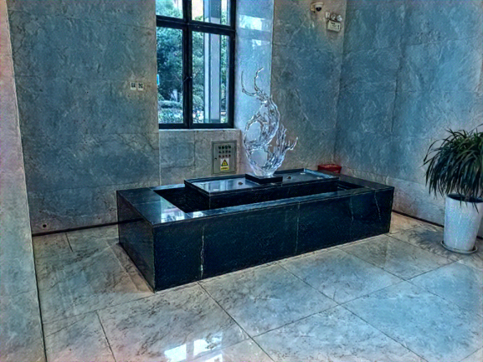
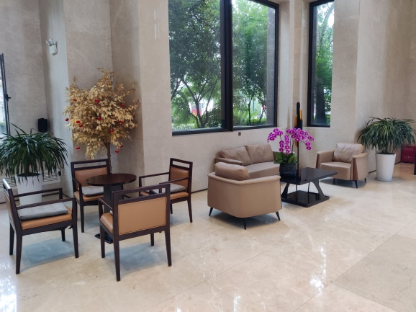
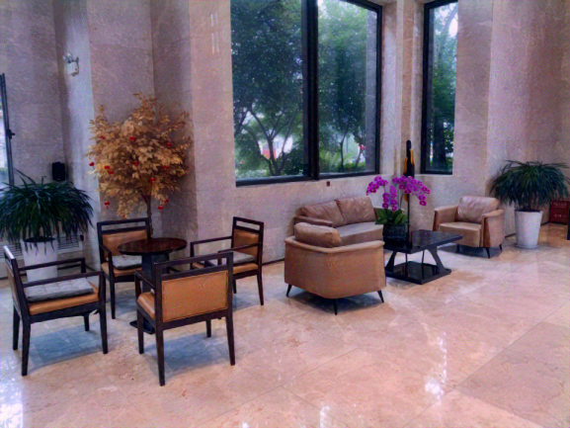
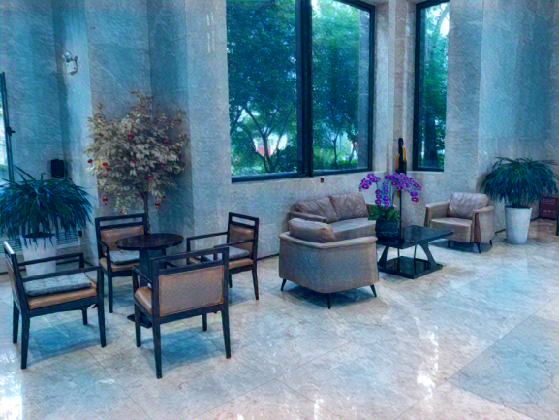
Filters

Slide 11
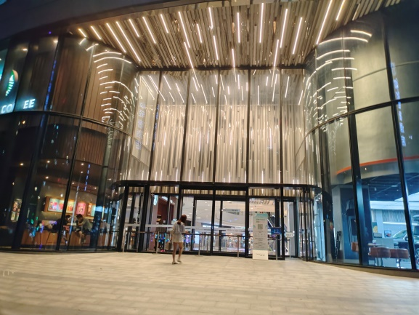
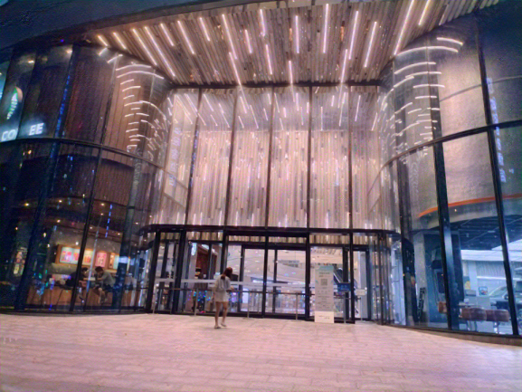
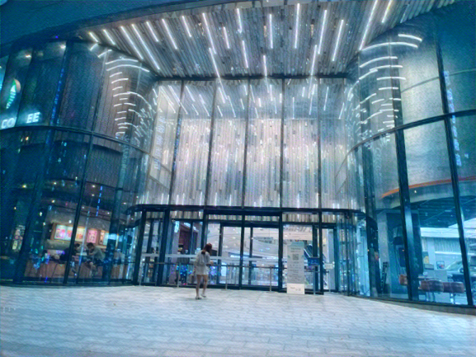
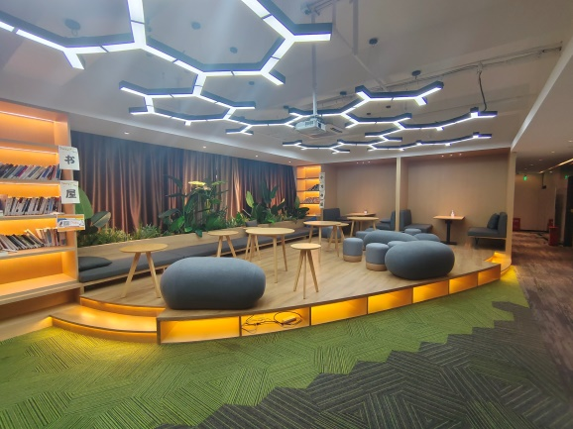
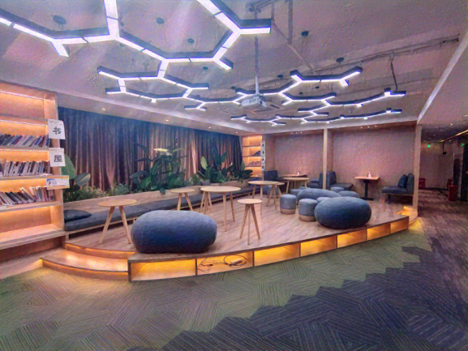
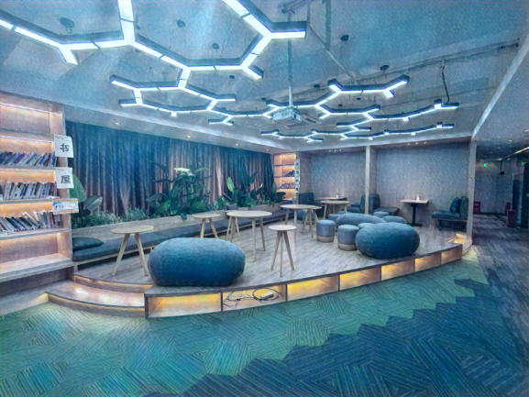
Filters

Slide 12
Art Style
Regarding image processing, the first thing that comes to our mind is the filters, which are mostly in the camera function option of our mobile phones.
Here we propose a solution to transform your painting style into Georges Braque, Maurits Cornelis Escher, Pablo Picasso, Salvador Dalíand. Therefore, AI makes art last forever.

Slide 13

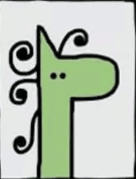





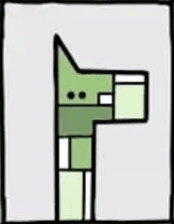
Art Style

Slide 14
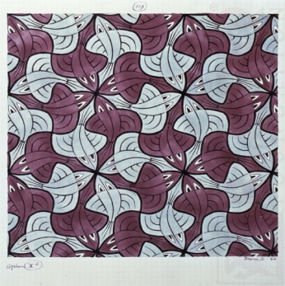
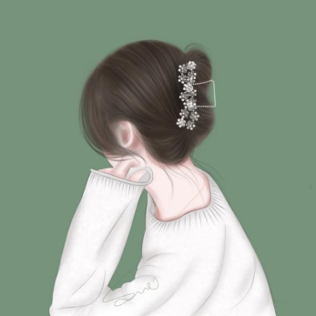
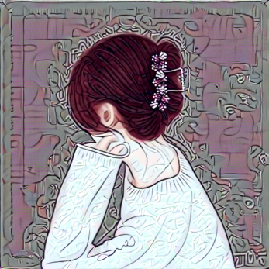
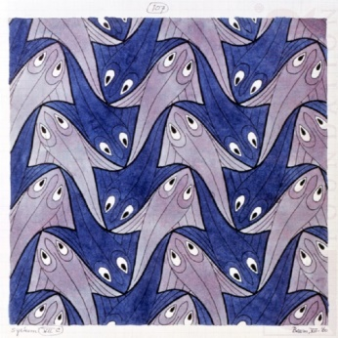
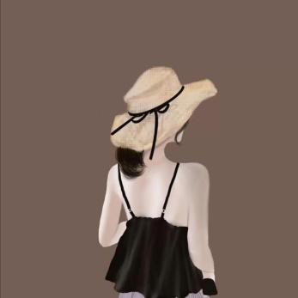
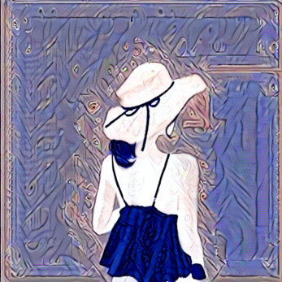
Portrait

Slide 15
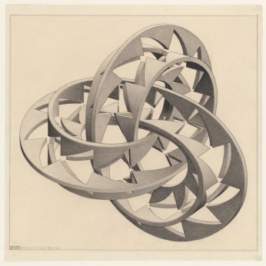

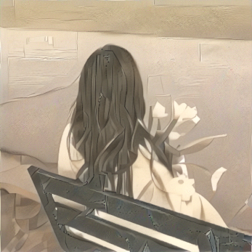
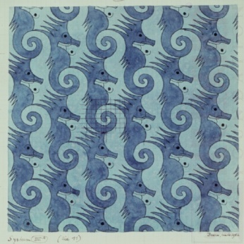
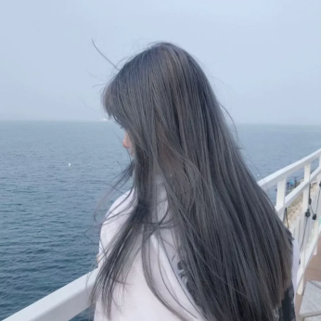
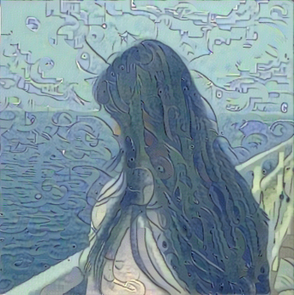
Portrait

Slide 16
Living Room Design
Step I: We have an image identification algorithm to transfer flat room plan to JSON file.
Step II: The JSON file can be imported into Unreal Engine 5.
Step III: We create a program to visualize the JSON file by creating a 3D scene of room, with which interior designers can do their works in Unreal Engine 5.

Slide 17
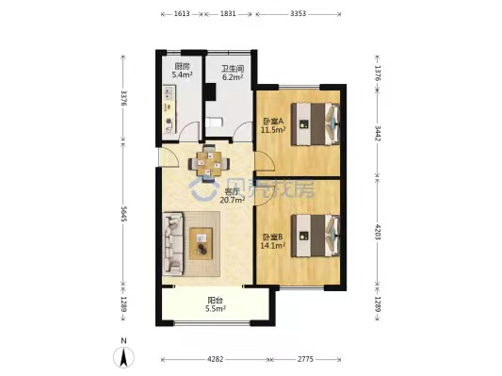
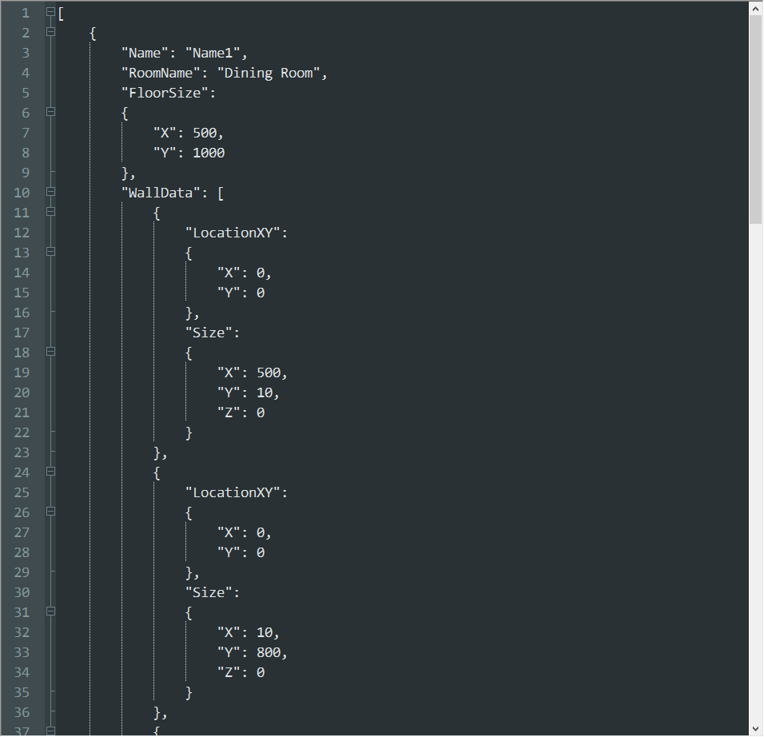
Text Recognization

Slide 18
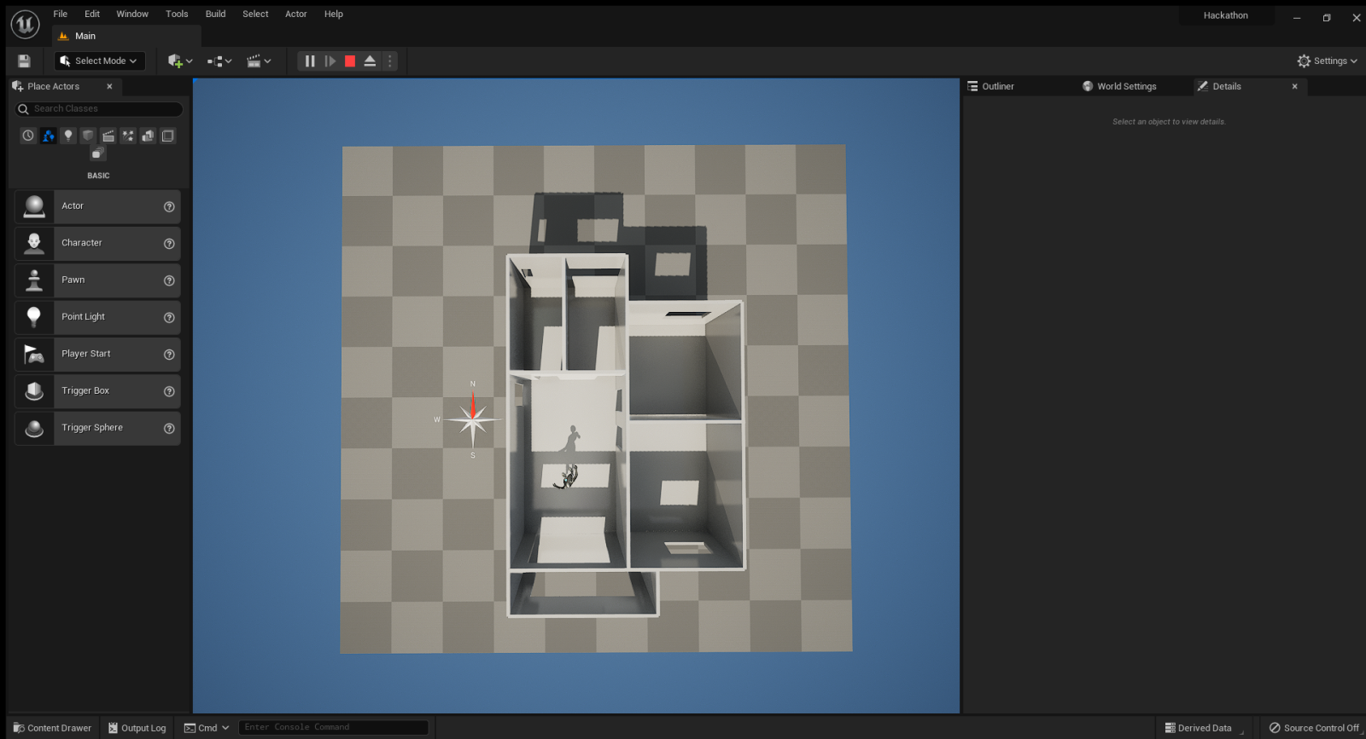
Living Room Design

Slide 19
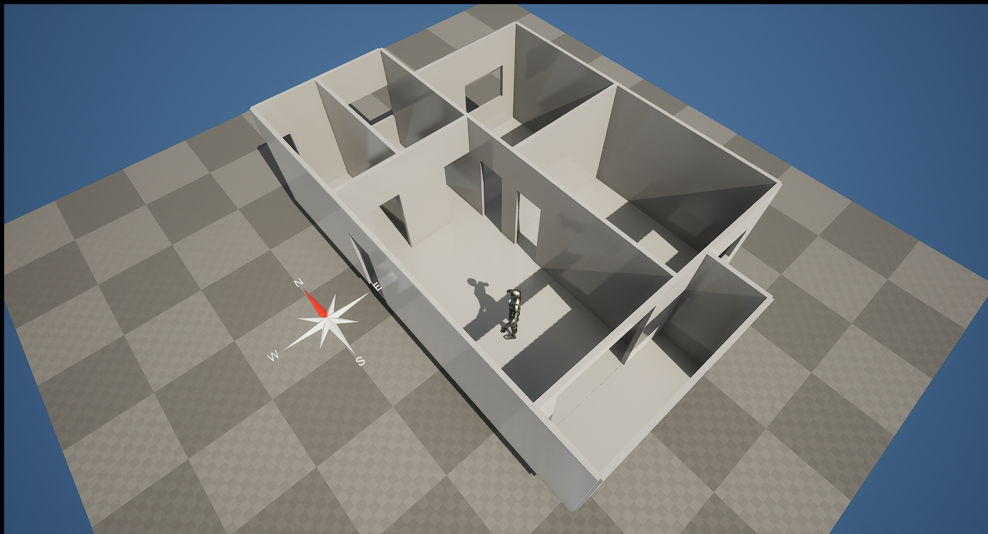
Side View

Slide 20
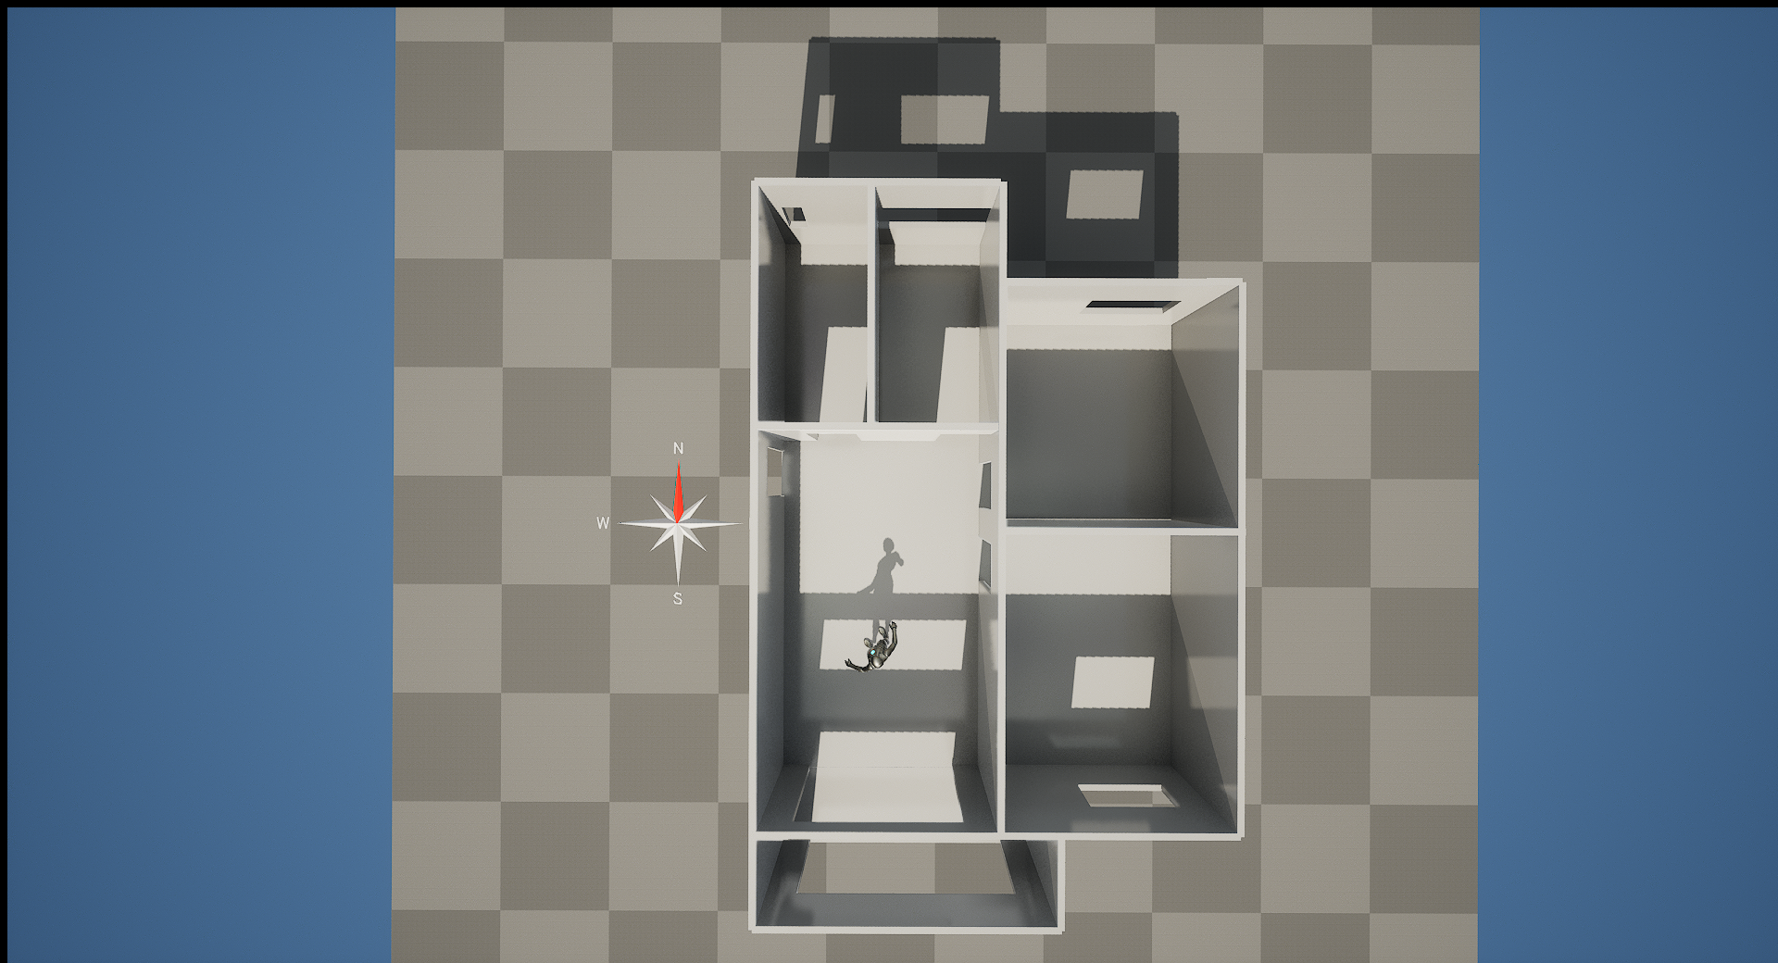
Top View

Slide 21
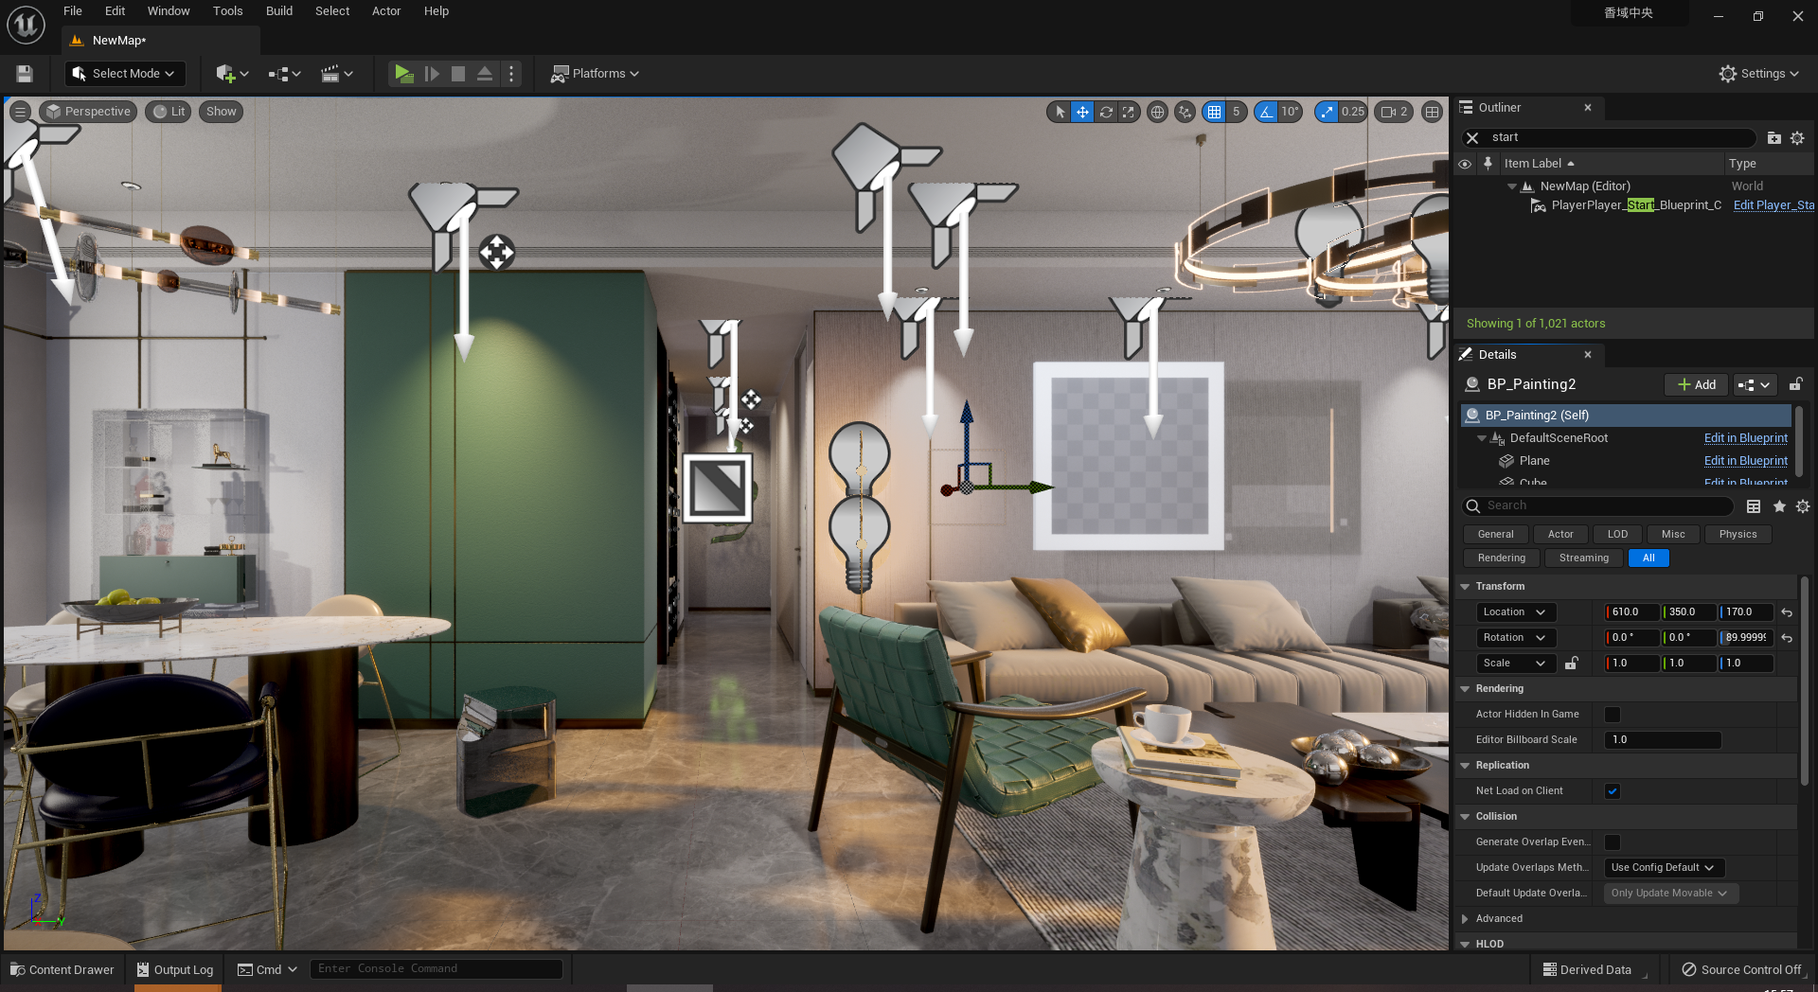

Slide 22
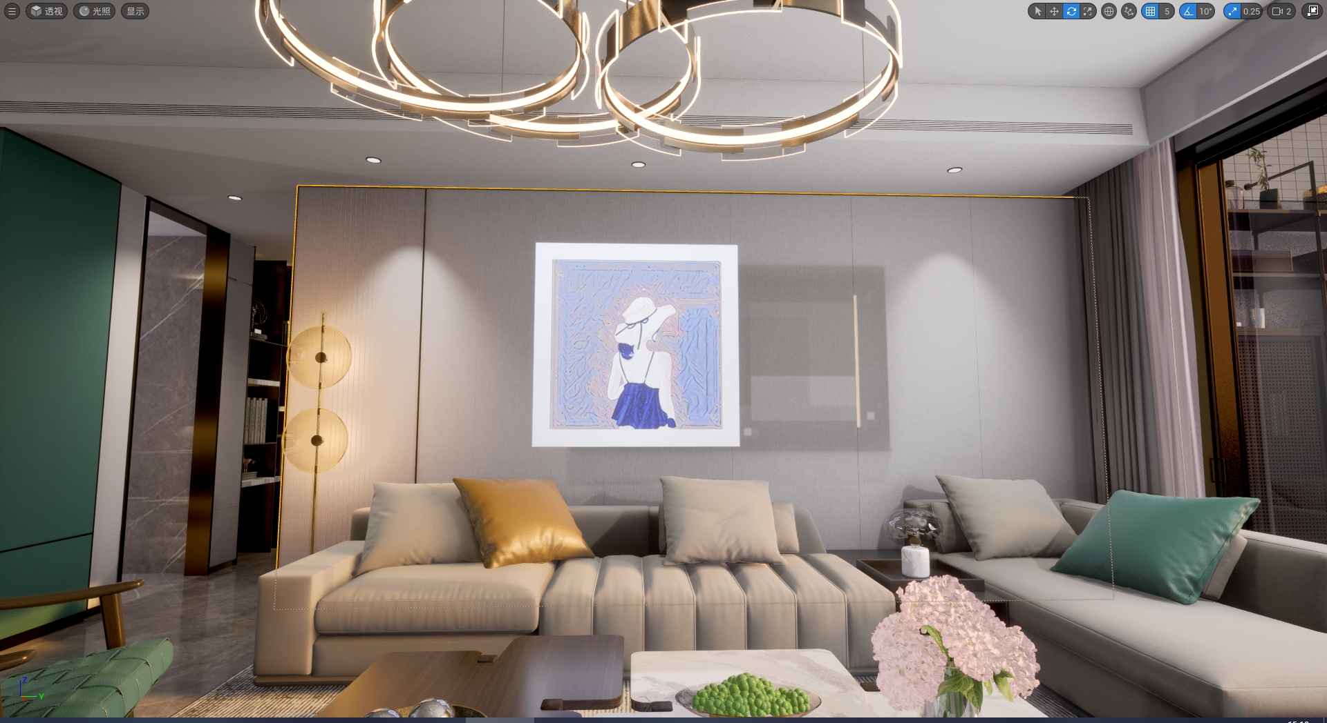

Slide 23
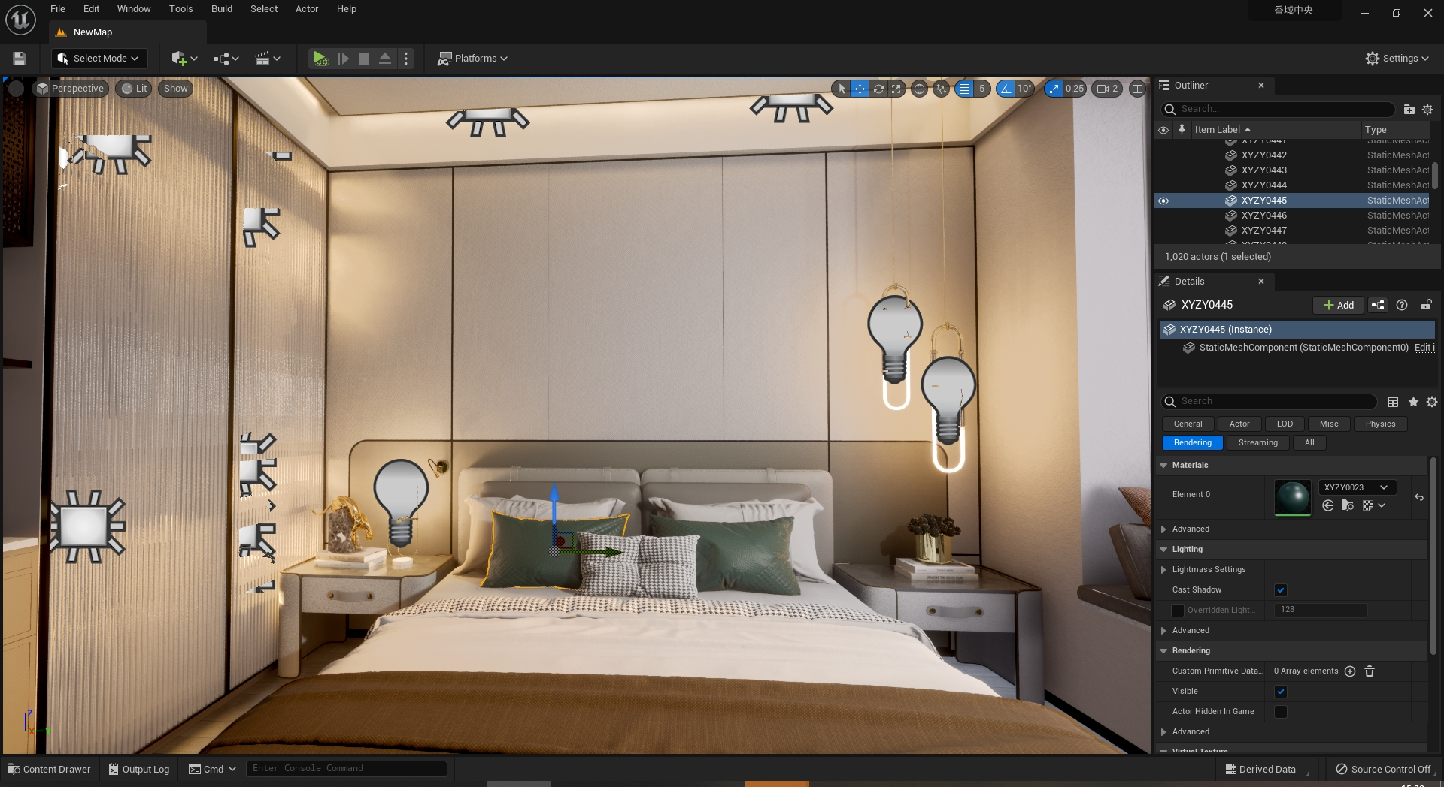

Slide 24
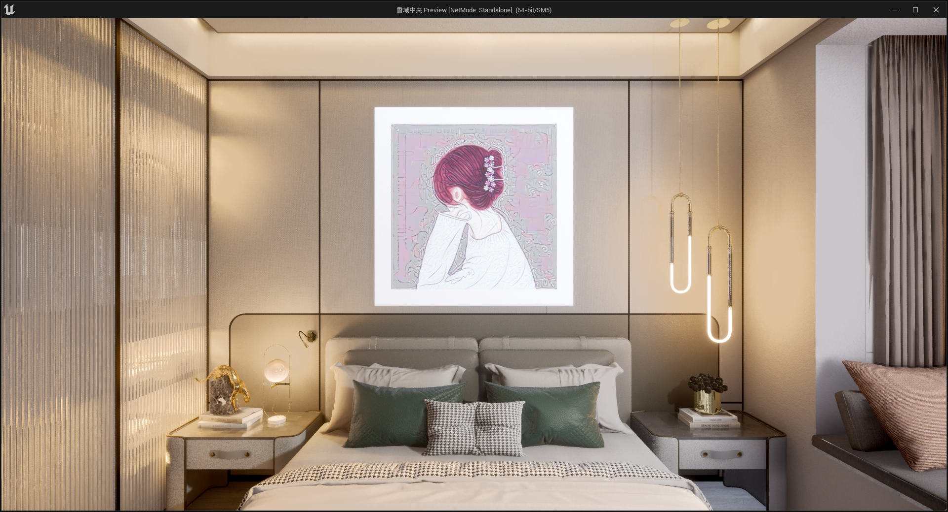

Slide 25
Conclusion
Provide creative copyright protection for the interior design industry
User created alter space owner and changed copyright owner
Copyright holders enable users to recreate via smart contracts

Slide 26

THANK YOU

